Slide 1
Acies Consulting LLP -Case Study Round
Front End Developer Intern Position
Submission by~
Shubham Jhanwar

Slide 2
Challenges:
Tabs to Display Distinct Graphs
Button to print Content of individual Tabs(Container) in PDF format.
Button to Print Content of All Tab in single page (PDF format).
Email Content

Slide 3
React Libraries/Methods That could be Usefull
TABS=====>
React Router,React Router DOM
PDF====>
Htmltopdf.js
Hooks====>(General Purpose in order to destructure the input etc.)
createRef, useState
Email===>
Regex, emailRegex
Graphs===>
Bar,Line Doughnut,etc. from react-chart-js2

Slide 4
Flow
index.js =(1)=> App.js =(2)=> Nav.js =(3)=> App.js =(4)=> Container.js =(5)=> Tab.js =(6)=> Container.js =(7)=> Emal.js=8=> Container.js=9=>App.js =(10)=> index.js
Style: A CSS File for UI purposes.
Kickin Starting the project by rendering(returns a DOM element by its id).
Imports and uses switch, router, redirect, etc, for routing purposes Switches,Router etc. as tabs are used. Asks value of path before that from Nav.js.
Creating tabs(links) and return to App.js.
Routes using the link to Container to display content for each tab.
Container uses switches to decide content for each tab by passing value to Tab.js(where Graphs are created).
Tab.js creates Graph for each individua ltab using the same data variable.returns to Container.
Container now has the data, calls createPDF from pdfWrapper.js, thus creates pdf;s of data and then cinvokes functionality like Print,Print all and Email are called.

Slide 5
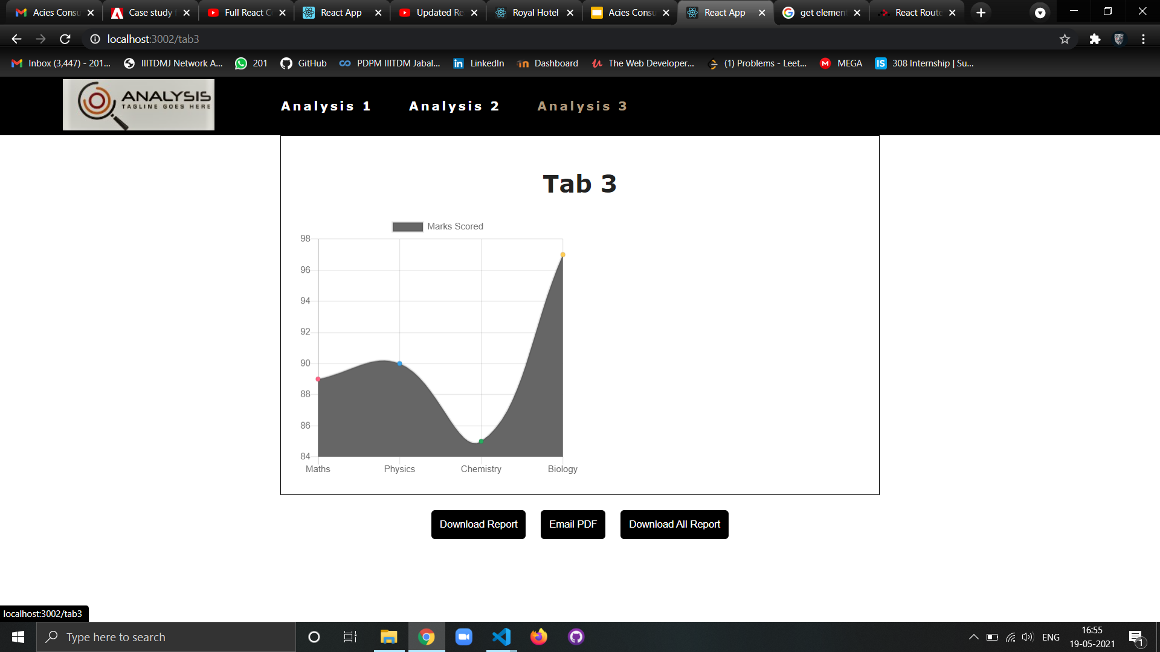
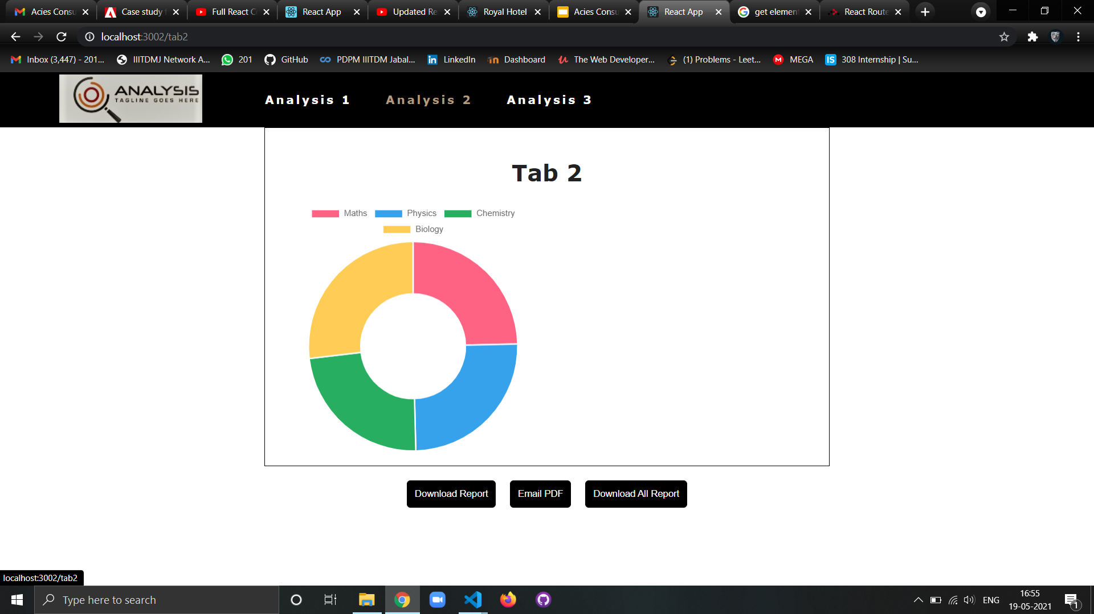
Results:

Slide 6
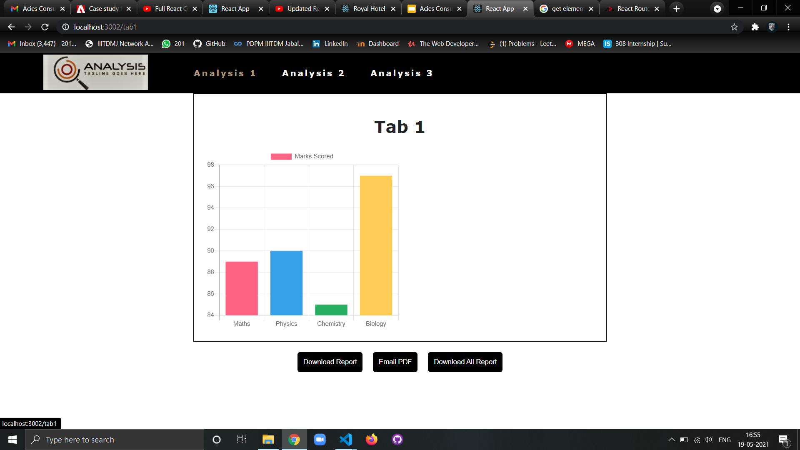

Slide 7
Thanks You for the opportunity

